Slide 1
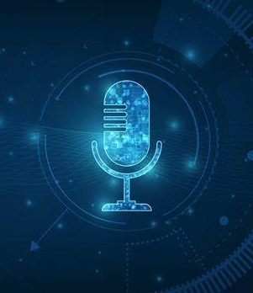
Voice Assistant-“Mini”
FABRIKAM RESIDENES
20DCS100- DHRUV RANGRAS
20DCS107- DARSH SHAH

Slide 2

INTRODUCTION
Basically we have created a project “voice assistant” named as ‘Mini’ in which we are going to make application that can control a device with voice command
01
02
It is a AI-based project.
Which recognize voice to do some task.
(if we say ‘open google’ then it will automatically open google)
03

Slide 3

REQUIREMENTS
PYTHON AND ITS LIBRARIES
pyttsx3
to speak out, or text to speech
01
Pywhatkit
For advance control of
browser
Date & time
06
02
To get current date and time
Speech Recognition-
05
03
Wikipedia
listen to our voice/speech
To get wikipedia data
04
pyjokes
To get funny jokes

Slide 4
MEDIUM
It would work on Android devices (will be included later).
You just need a Windows PC/Laptop and it can run on it.

Slide 5
ADVANTAGES
We can manage our device using voice.
More flexible than a dialogue interface.
It enables hands-free operations.
Suitable for physically handicapped people

Slide 6
REFERENCES
01
GitHub - jaspreetsidhu3/voice_assistant: Amigo is voice assistant similar to Siri, Alexa, google assistance and Cortana which can perform various tasks.
02
https://youtu.be/SXsyLdKkKX0 Intelligent Voice Assistant in Python - YouTube
How to build your own AI personal assistant using Python | by M.Mirthula | Towards Data Science
03
04
Build Your Own Voice Assistant with Python - CodeSpeedy

Slide 7

THANK YOU

